Slide 1
GOOD MORNING
EVERYONE !!!

Slide 2
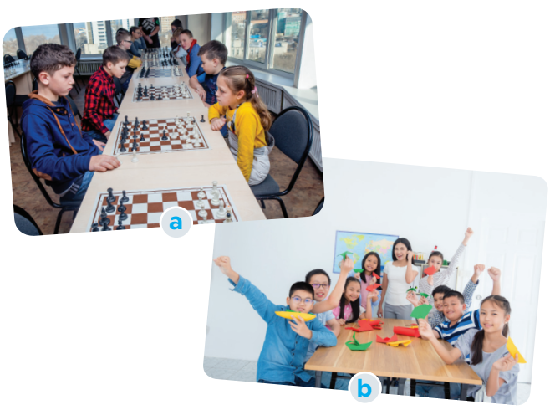
* WARM-UP
BRAINSTORMING
1
Work in pairs:
a. Look at the picture and say what club it is.
Chess club
Arts and crafts club
b. Which of your school clubs do you want to join?

Slide 3
Unit
3
TEENAGERS
LESSON 5: SKILLS 1

Slide 4
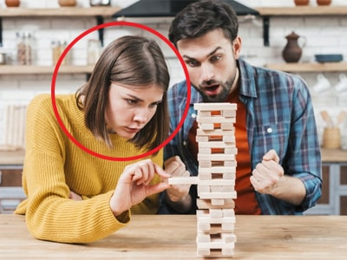
* VOCABULARY
concentrate (v):
tập trung
/ˈkɒnsntreɪt/

Slide 5
* VOCABULARY
focused (adj):
chuyên tâm, tập trung
/ˈfəʊkəst/

Slide 6
* VOCABULARY
craft (n):
(nghề, đồ, kỹ nghệ) thủ công
/krɑːft/

Slide 7
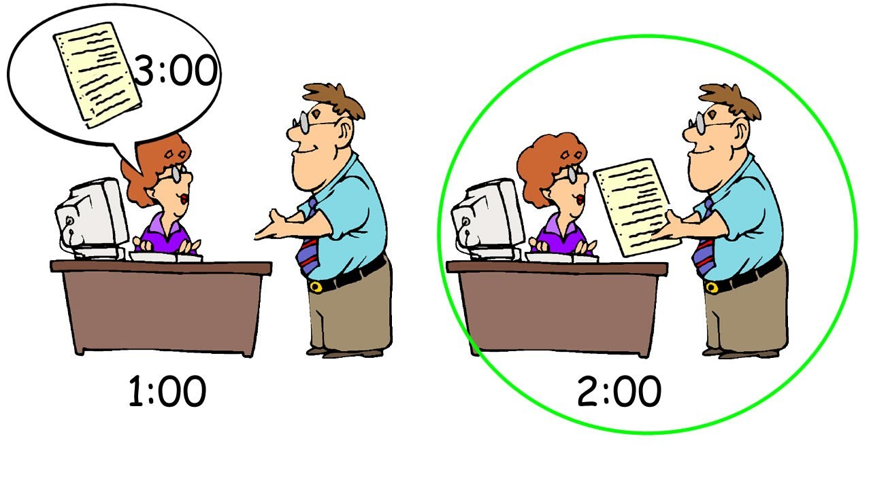
* VOCABULARY
beforehand (adv):
trước
/bɪˈfɔːhænd/

Slide 8
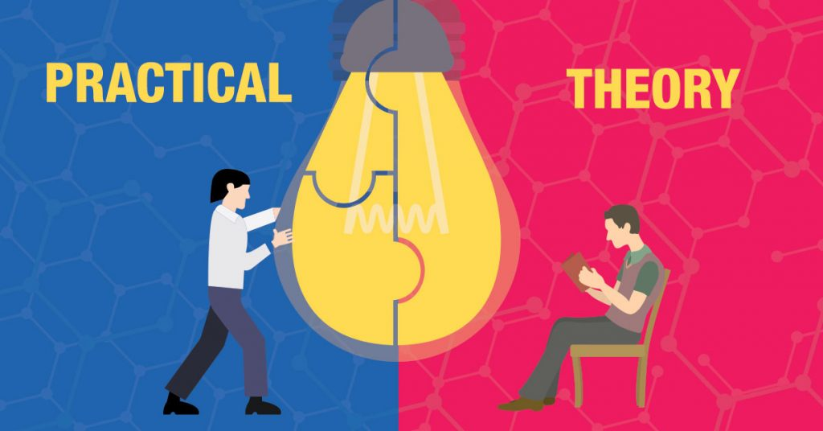
* VOCABULARY
practical (adj):
thực tế, thực tiễn
/ˈpræktɪkl/

Slide 9
*VOCABULARY
New words | Pronunciation | Meaning
1. concentrate (v) | /ˈkɒnsntreɪt/ | tập trung
2. focused (adj) |  | chuyên tâm, tập trung
3. craft (n) | /krɑːft/ | thủ công
4. beforehand (adv) | /bɪˈfɔːhænd/ | trước
5. practical (adj) | /ˈpræktɪkl/ | thực tế, thực tiễn

Slide 10
* Checking vocab
What and Where
practical
craft
focused
beforehand
concentrate

Slide 11
I. READING
2
Read the conversation and tick T (true) or F (false) for each sentence.
Mai: Tom, so which club do you want to join?
Tom: I’m interested in two clubs: badminton and chess.
Mai: I like badminton, too. It’s relaxing.
Tom: Yes, I play it to keep fit. So let’s join that club together.
Mai: OK. It’s on Tuesdays and Fridays from 5:00 p.m. to 6:30 p.m. It starts 30 minutes after school, so we have enough time to get some snacks beforehand. I know you like chess. Will you join the chess club?
Tom: Well, I started playing it five years ago. My mum first sent me to a chess club because she wanted me to be more focused. Now I find that I can concentrate better. Do you like chess? Let’s join the chess club too.
Mai: Actually, this year there is a new arts and crafts club, and I want to join it. I hear that the members will work together in small community service projects. Members can do art projects and also improve their practical skills and teamwork skills too.
Tom: Awesome, Mai. Who will coach that club?
Mai: Ms Hoa, the art teacher. She will help us connect with the community.

Slide 12
I.READING
2
Read the conversation and tick T (true) or F (false) for each sentence.
Sentences | T | F
1. The school has badminton, chess, and arts and crafts clubs.
2. The badminton club activities are after school.
3. Tom started playing chess when he was five.
4. Members of the arts and crafts club do community activities.
five years ago

Slide 13
3
Read the conversation again and choose the correct answer A, B, or C
1. Tom and Mai are discussing ______________. A. their leisure time activities B. their school club activities C. their likes and dislikes 2. Tom started playing chess because ________. A. he loved it B. he wanted to stay focused C. his mum wanted him to play 3. Playing chess helps Tom _______________. A. connect with other members B. concentrate better C. do community service | 4. The word “it” refers to ____________. A. chess club B. arts and crafts club C. community service 5. Mai will participate in the arts and crafts club to _____________. A. help the school B. coach her friends C. do art projects
Game

Slide 14
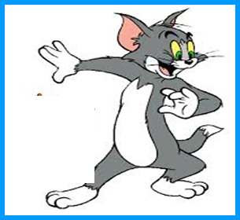
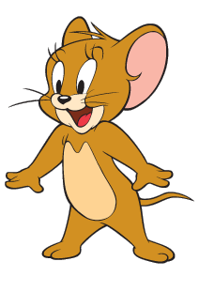
Game: Lucky numbers
1
2
3
4
5
6
7
8

Slide 15
3
Read the conversation again and choose the correct answer A, B, or C
1. Tom and Mai are discussing _________.
A. their leisure time activities
B. their school club activities
C. their likes and dislikes

Slide 16
3
Read the conversation again and choose the correct answer A, B, or C
2. Tom started playing chess because ________.
A. he loved it
B. he wanted to stay focused
C. his mum wanted him to play

Slide 17
3
Read the conversation again and choose the correct answer A, B, or C
3. Playing chess helps Tom________.
A. connect with other members
B. concentrate better
C. do community service

Slide 18
3
Read the conversation again and choose the correct answer A, B, or C
4. The word “it” refers________.
A. chess club
B. arts and crafts club
C. community service

Slide 19
3
Read the conversation again and choose the correct answer A, B, or C
5. Mai will participate in the arts and crafts club to ________.
A. help the school
B. coach her friends
C. do art projects

Slide 20
LUCKY NUMBER
LUCKY NUMBER
you get 2 plus points

Slide 21
LUCKY NUMBER
LUCKY NUMBER
you get 2 plus points

Slide 22
UNLUCKY NUMBER

Slide 23
3
Read the conversation again and choose the correct answer A, B, or C
1. Tom and Mai are discussing ______________. A. their leisure time activities B. their school club activities C. their likes and dislikes 2. Tom started playing chess because ________. A. he loved it B. he wanted to stay focused C. his mum wanted him to play 3. Playing chess helps Tom _______________. A. connect with other members B. concentrate better C. do community service | 4. The word “it” refers to ____________. A. chess club B. arts and crafts club C. community service 5. Mai will participate in the arts and crafts club to _____________. A. help the school B. coach her friends C. do art projects

Slide 24
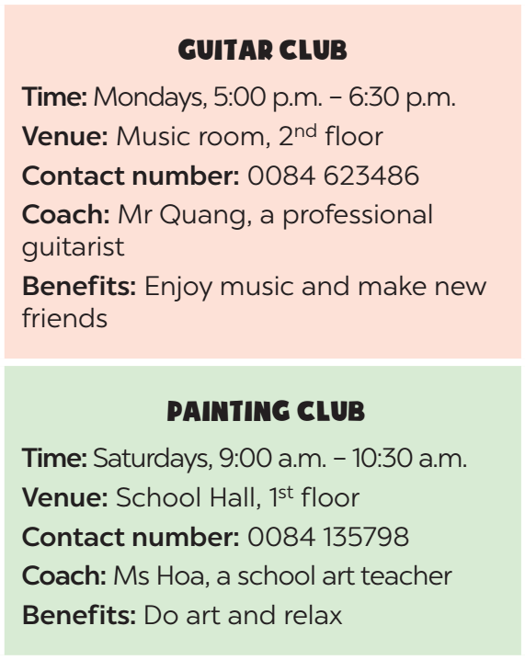
II.SPEAKING
4
Work in groups. Make conversations using the given information.
Suggested questions:
- Which club do you join in?
- What time does the club meet?
- Where does it meet?
- How can I contact the club? / What is the contact number of the club?
- Who coaches the club?
- What are the benefits you get when you join the club? / Why do you want to join this club?

Slide 25
II.SPEAKING
4
Work in groups. Make conversations using the given information.
A: Which club do you join in?
B: I join in guitar club
A: What time does the guitar club meet?
B: It meets on Mondays, from 5:00 p.m. to 6:30 p.m.
A: Where does it meet?
B: It meets in the music room, on the second floor.
A: Who coaches the club?
B: It’s Mr Quang, a professional guitarist.
A: What are the benefits you get when you join the club?
B: You can enjoy music and make new friends.

Slide 26
II.SPEAKING
4
Work in groups. Make conversations using the given information.
A: Which club do you join in?
B: I join in guitar club
A: What time does the guitar club meet?
B: It meets on Mondays, from 5:00 p.m. to 6:30 p.m.
A: Where does it meet?
B: It meets in the music room, on the second floor.
A: Who coaches the club?
B: It’s Mr Quang, a professional guitarist.
A: What are the benefits you get when you join the club?
B: You can enjoy music and make new friends.

Slide 27
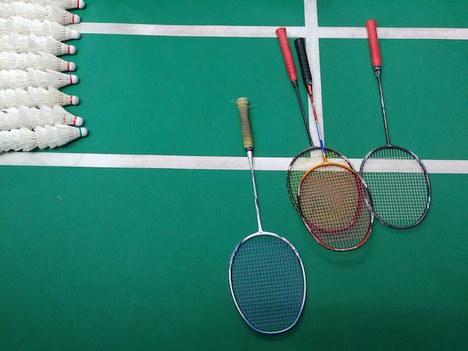
5
Work in groups. Ask and answer questions about a club at your school. Report the answers to your class.
The badminton club at my school meets on Tuesdays, from 4:30 p.m. to 6:00p.m. It meets in my schoolyard, Mr Chung , a PE teacher, will coach us. At the club We can practice playing badminton , sometimes compete between teams and we can make new friends.

Slide 28
* CONSOLIDATION
Retell some school clubs they have learned after the lesson and their benefits.

Slide 29
* Homework
Learn by heart vocab.
Do exercises in the workbook.
- Prepare for the next lesson: Unit 3-Skills 2.

Slide 30
Thank you!
Goodbye!

